Slide 1
Adam Optimization (Adaptive Moment Estimation)

Slide 2
Adam merges momentum and learning decay
Uses estimations of first and second moments of gradient to adapt the learning rate for each weight of the neural network
In Statistics, Moments are popularly used to describe the characteristic of a distribution
These are very useful in statistics because they tell you much about your data

Slide 3
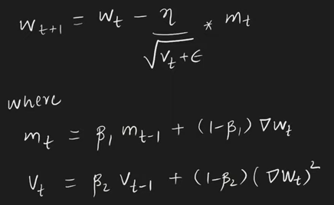

Slide 4
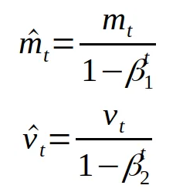
Recall Bias correction

Slide 5
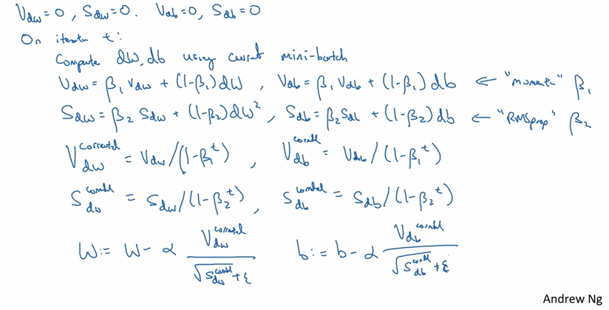

Slide 6
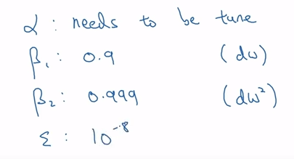
Usually used hyperparameter choices

Slide 7
Animation of 5 gradient descent methods on a surface:
Gradient descent (cyan)
Momentum (magenta)
AdaGrad (white) ☺
RMSProp (green)
Adam (blue)
Left well is the global minimum; right well is a local minimum.
https://towardsdatascience.com/a-visual-explanation-of-gradient-descent-methods-momentum-adagrad-rmsprop-adam-f898b102325c

